Slide 1
Sparse vs. Ensemble Approaches to Supervised Learning
Greg Grudic
Modified by Longin Jan Latecki
Some slides are by Piyush Rai
Intro AI
Ensembles

Slide 2
Goal of Supervised Learning?
Minimize the probability of model prediction errors on future data
Two Competing Methodologies
  Build one really good model
    Traditional approach
  Build many models and average the results
    Ensemble learning (more recent)
Intro AI
Ensembles

Slide 3
The Single Model Philosophy
Motivation: Occam’s Razor
  “one should not increase, beyond what is necessary, the number of entities required to explain anything”
Infinitely many models can explain any given dataset
  Might as well pick the smallest one…
Intro AI
Ensembles

Slide 4
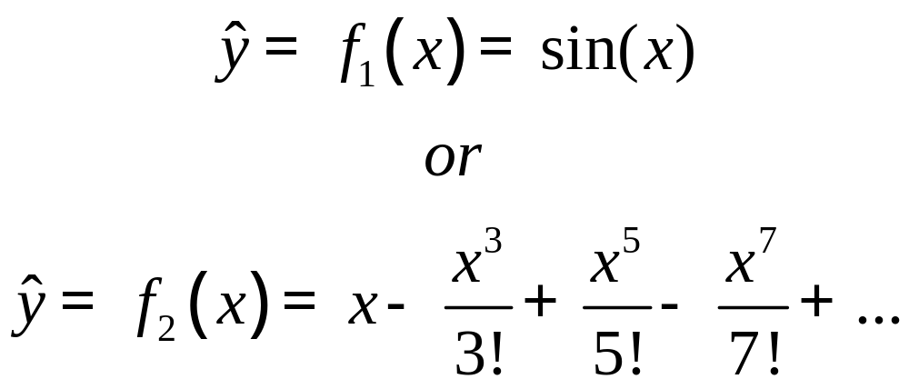

Which Model is Smaller?
In this case
It’s not always easy to define small!
Intro AI
Ensembles

Slide 5
Exact Occam’s Razor Models
Exact approaches find optimal solutions
Examples:
  Support Vector Machines
    Find a model structure that uses the smallest percentage of training data (to explain the rest of it).
  Bayesian approaches
    Minimum description length
Intro AI
Ensembles

Slide 6
How Do Support Vector Machines Define Small?
Minimize the number
of Support Vectors!
Maximized
Margin
Intro AI
Ensembles

Slide 7
Approximate Occam’s Razor Models
Approximate solutions use a greedy search approach which is not optimal
Examples
  Kernel Projection Pursuit algorithms
    Find a minimal set of kernel projections
  Relevance Vector Machines
    Approximate Bayesian approach
  Sparse Minimax Probability Machine Classification
    Find a minimum set of kernels and features
Intro AI
Ensembles

Slide 8
Other Single Models: Not Necessarily Motivated by Occam’s Razor
Minimax Probability Machine (MPM)
Trees
  Greedy approach to sparseness
Neural Networks
Nearest Neighbor
Basis Function Models
  e.g. Kernel Ridge Regression
Intro AI
Ensembles

Slide 9
Ensemble Philosophy
Build many models and combine them
Only through averaging do we get at the truth!
It’s too hard (impossible?) to build a single model that works best
Two types of approaches:
  Models that don’t use randomness
  Models that incorporate randomness
Intro AI
Ensembles

Slide 10
Ensemble Approaches
Bagging
  Bootstrap aggregating
Boosting
Random Forests
  Bagging reborn
Intro AI
Ensembles

Slide 11
Bagging
Main Assumption:
  Combining many unstable predictors to produce a ensemble (stable) predictor.
  Unstable Predictor: small changes in training data produce large changes in the model.
    e.g. Neural Nets, trees
    Stable: SVM (sometimes), Nearest Neighbor.
Hypothesis Space
  Variable size (nonparametric):
    Can model any function if you use an appropriate predictor (e.g. trees)
Intro AI
Ensembles

Slide 12
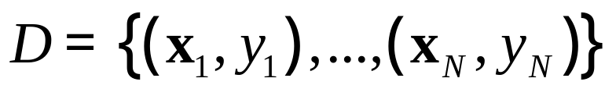
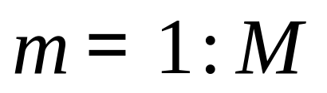
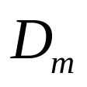

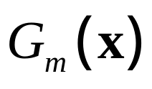
The Bagging Algorithm
Given data:
For
Obtain bootstrap sample from the training data
Build a model from bootstrap data
Intro AI
Ensembles

Slide 13
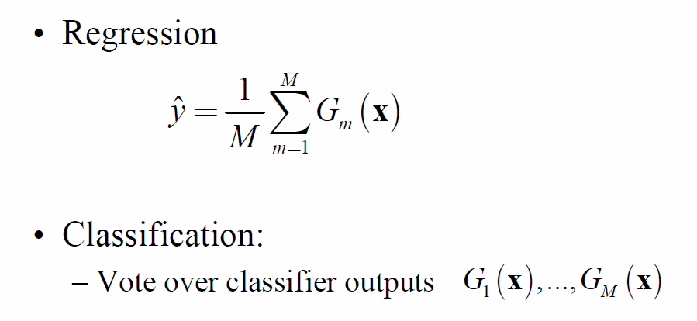
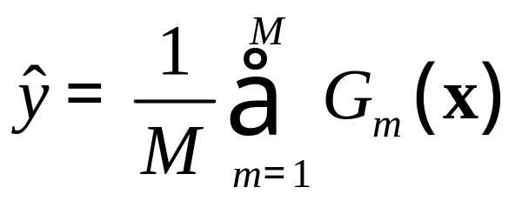
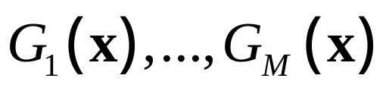
The Bagging Model
Regression
Classification:
  Vote over classifier outputs
Intro AI
Ensembles

Slide 14
Bagging Details
Bootstrap sample of N instances is obtained by drawing N examples at random, with replacement.
On average each bootstrap sample has 63% of instances
  Encourages predictors to have uncorrelated errors
    This is why it works
Intro AI
Ensembles

Slide 15
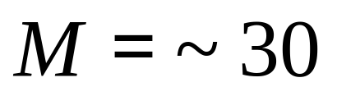

Bagging Details 2
Usually set
  Or use validation data to pick
The models need to be unstable
  Usually full length (or slightly pruned) decision trees.
Intro AI
Ensembles

Slide 16
Boosting
  Main Assumption:
    Combining many weak predictors (e.g. tree stumps or 1-R predictors) to produce an ensemble predictor
    The weak predictors or classifiers need to be stable
  Hypothesis Space
    Variable size (nonparametric):
      Can model any function if you use an appropriate predictor (e.g. trees)
Intro AI
Ensembles

Slide 17
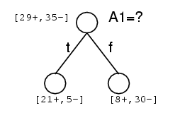
Commonly Used Weak Predictor
(or classifier)
  A Decision Tree Stump (1-R)
Intro AI
Ensembles

Slide 18
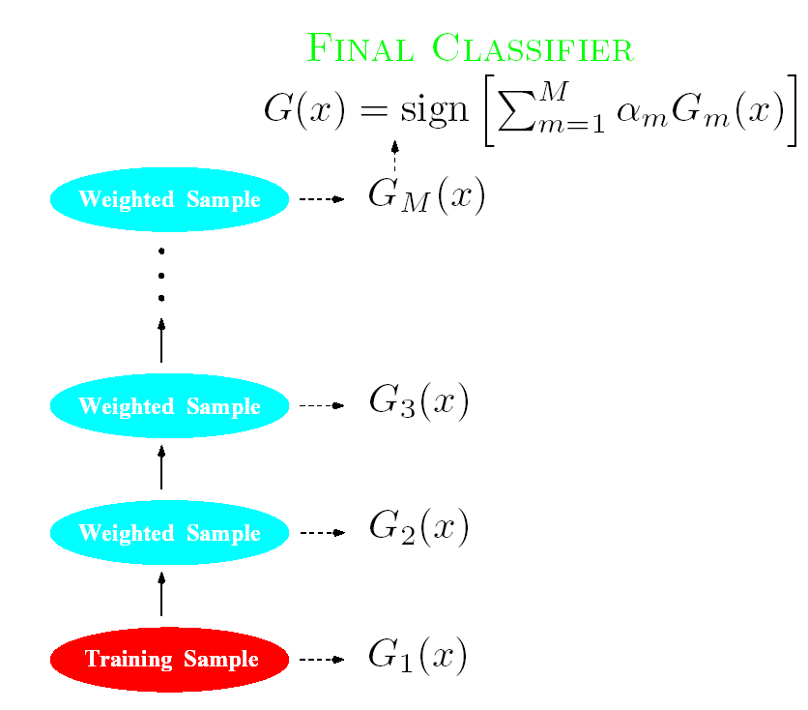
Boosting
Each classifier is
trained from a weighted
Sample of the training
Data
Intro AI
Ensembles

Slide 19
Boosting (Continued)
Each predictor is created by using a biased sample of the training data
  Instances (training examples) with high error are weighted higher than those with lower error
Difficult instances get more attention
  This is the motivation behind boosting
Intro AI
Ensembles

Slide 20
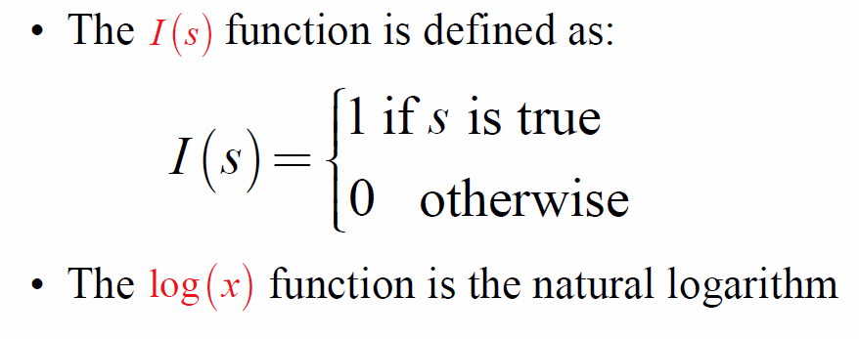
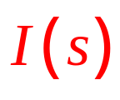
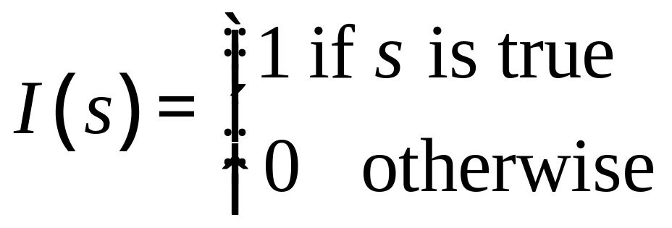
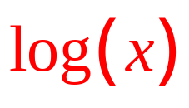
Background Notation
The function is defined as:
The function is the natural logarithm
Intro AI
Ensembles

Slide 21
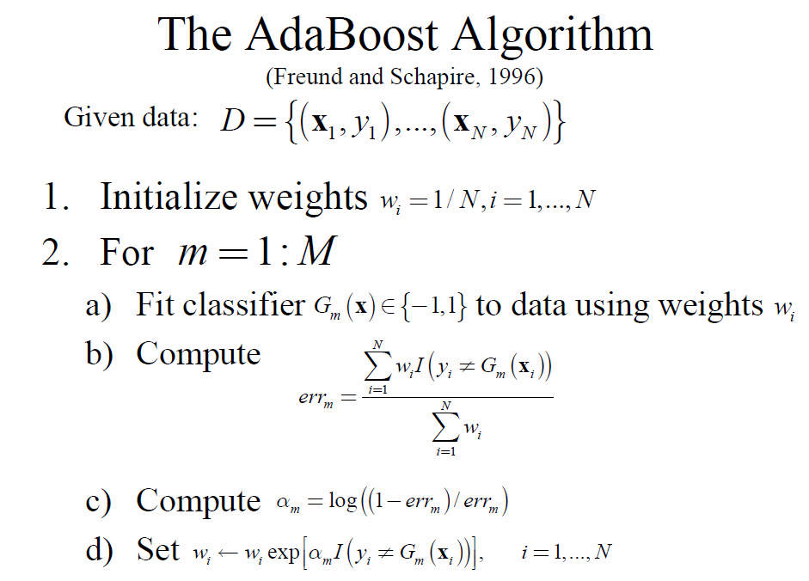



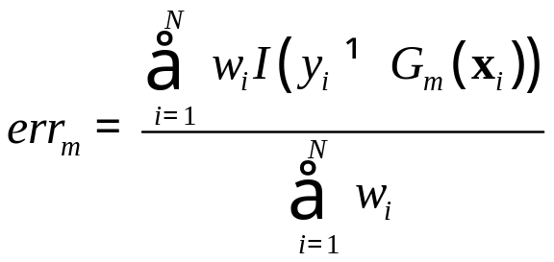


The AdaBoost Algorithm
(Freund and Schapire, 1996)
Given data:
Initialize weights
For
  Fit classifier to data using weights
  Compute
  Compute
  Set
Intro AI
Ensembles

Slide 22
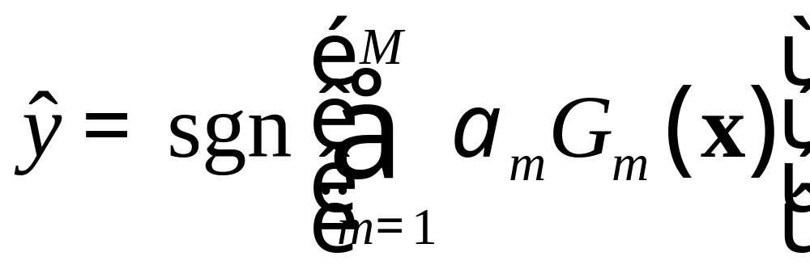
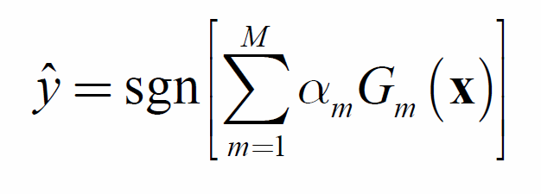
The AdaBoost Model
AdaBoost is NOT used for Regression!
Intro AI
Ensembles

Slide 23
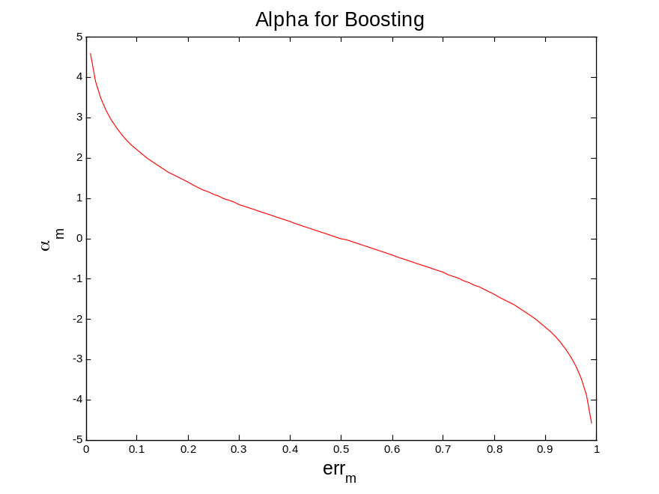
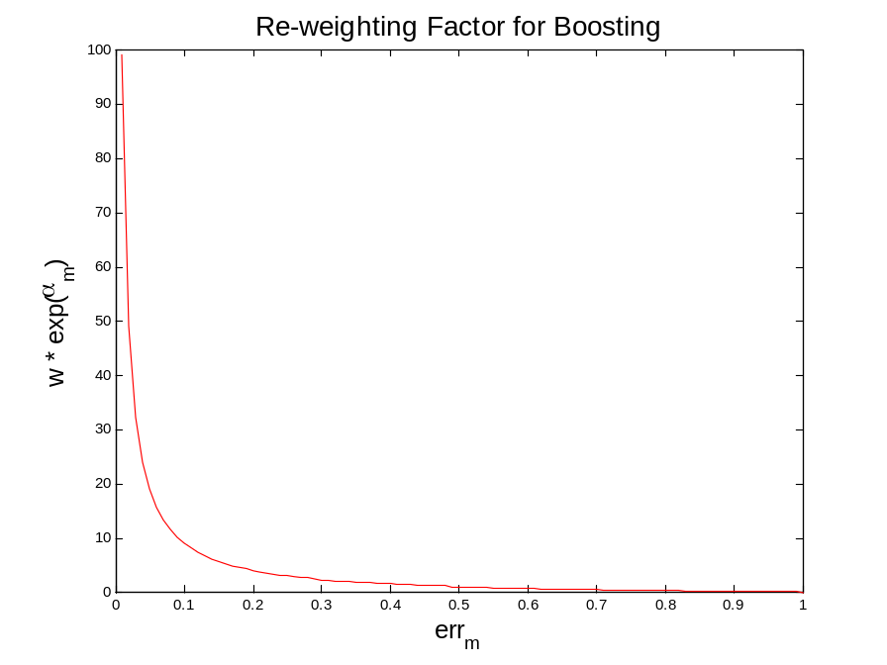
The Updates in Boosting
Intro AI
Ensembles

Slide 24
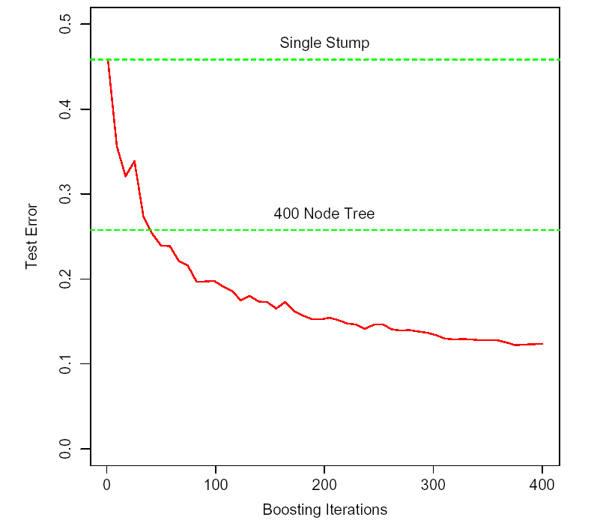
Boosting Characteristics
Simulated data: test error rate for boosting with stumps, as a function of the number of iterations. Also shown are the test error rate for a single stump, and a 400 node tree.
Intro AI
Ensembles

Slide 25
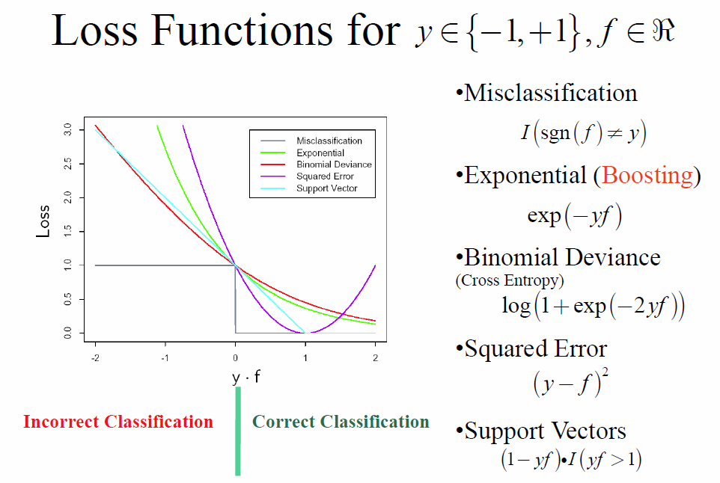
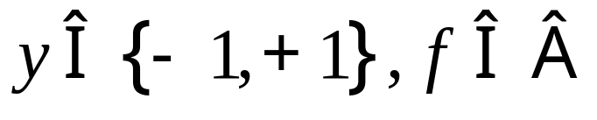
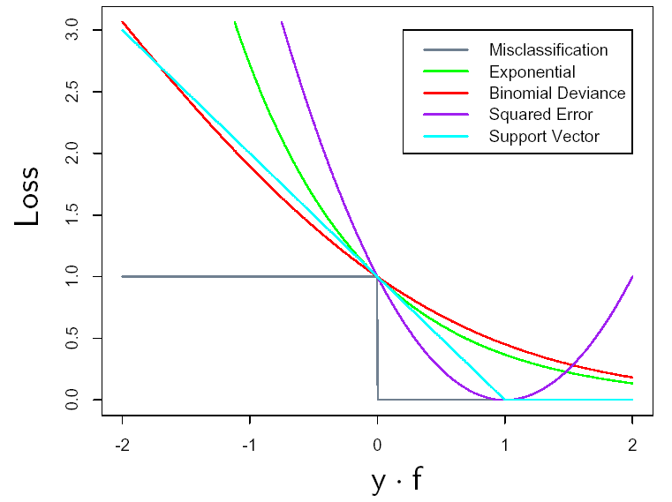

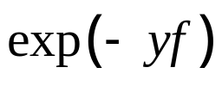
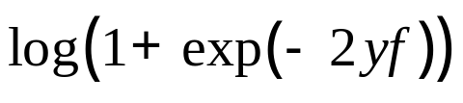
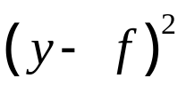

Loss Functions for
Misclassification
Exponential (Boosting)
Binomial Deviance (Cross Entropy)
Squared Error
Support Vectors
Incorrect Classification
Correct Classification
Intro AI
Ensembles

Slide 26
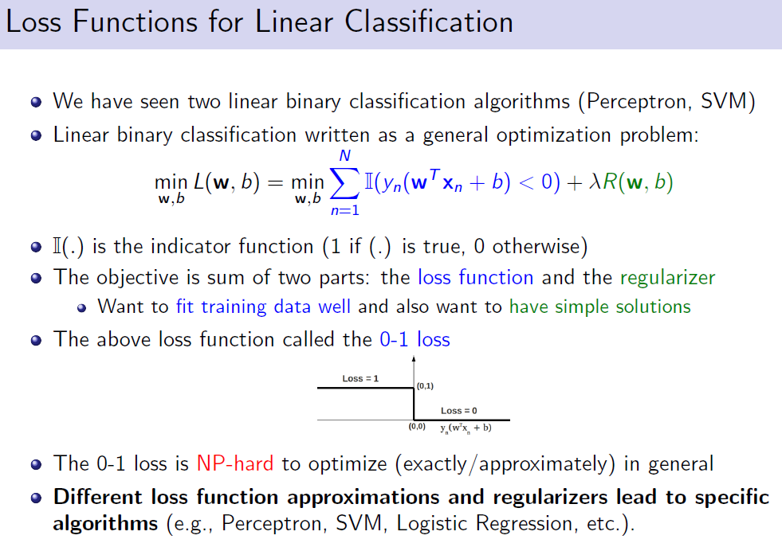
Intro AI
Ensembles

Slide 27
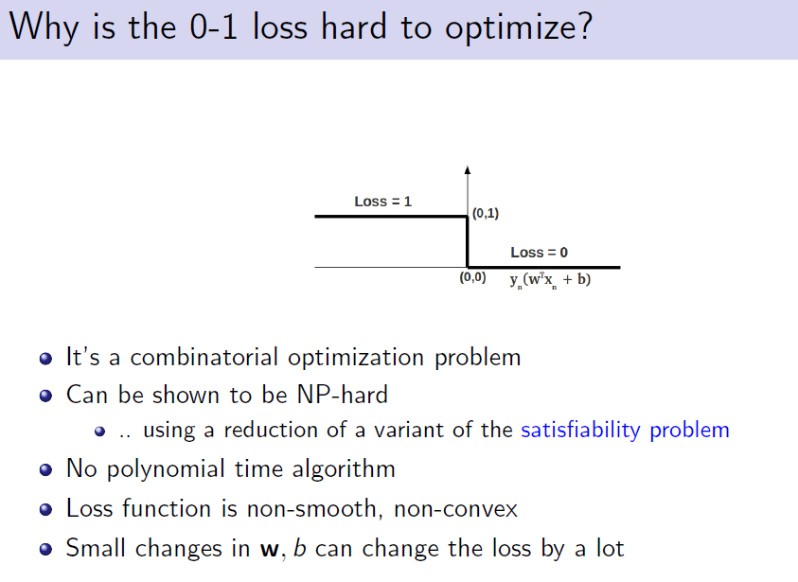
Intro AI
Ensembles

Slide 28
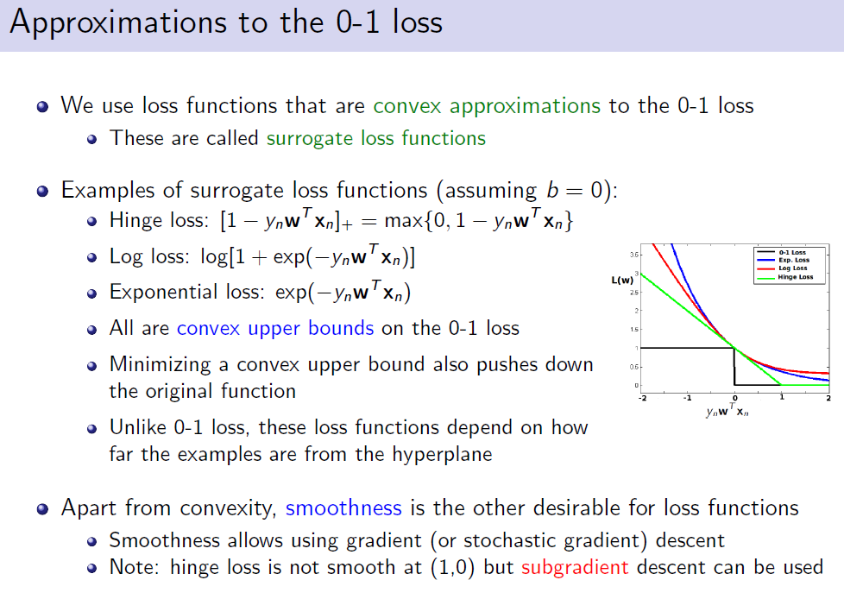
Intro AI
Ensembles

Slide 29
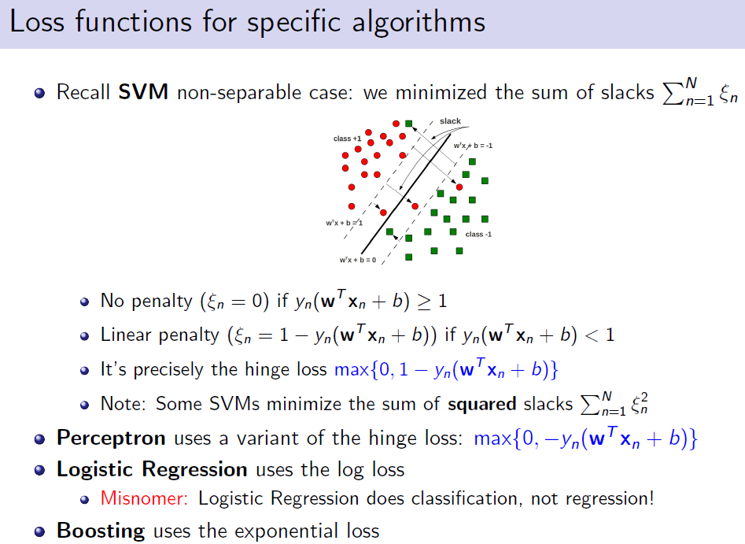
Intro AI
Ensembles

Slide 30
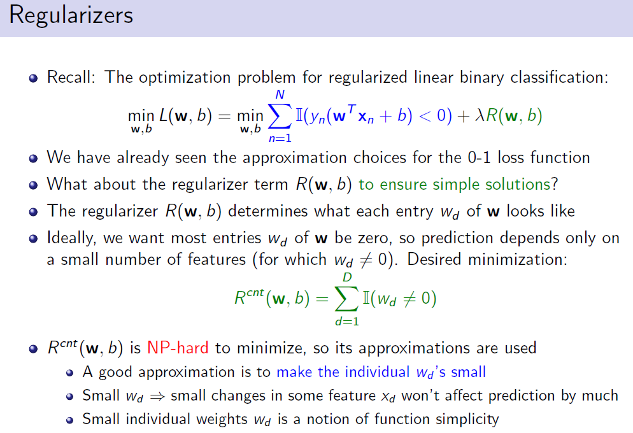
Intro AI
Ensembles

Slide 31
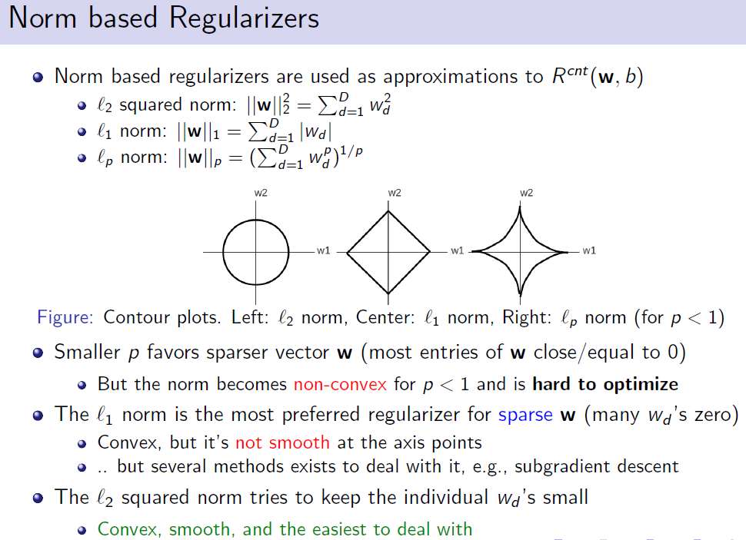
Intro AI
Ensembles

Slide 32
Other Variations of Boosting
Gradient Boosting
  Can use any cost function
Stochastic (Gradient) Boosting
  Bootstrap Sample: Uniform random sampling (with replacement)
  Often outperforms the non-random version
Intro AI
Ensembles

Slide 33
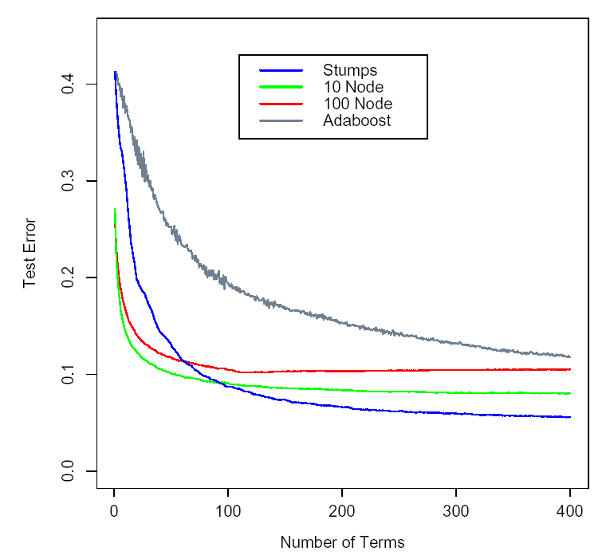
Gradient Boosting
Intro AI
Ensembles

Slide 34
Boosting Summary
Good points
  Fast learning
  Capable of learning any function (given appropriate weak learner)
  Feature weighting
  Very little parameter tuning
Bad points
  Can overfit data
  Only for binary classification
Learning parameters (picked via cross validation)
  Size of tree
  When to stop
Software
  http://www-stat.stanford.edu/~jhf/R-MART.html
Intro AI
Ensembles

